Slide 1
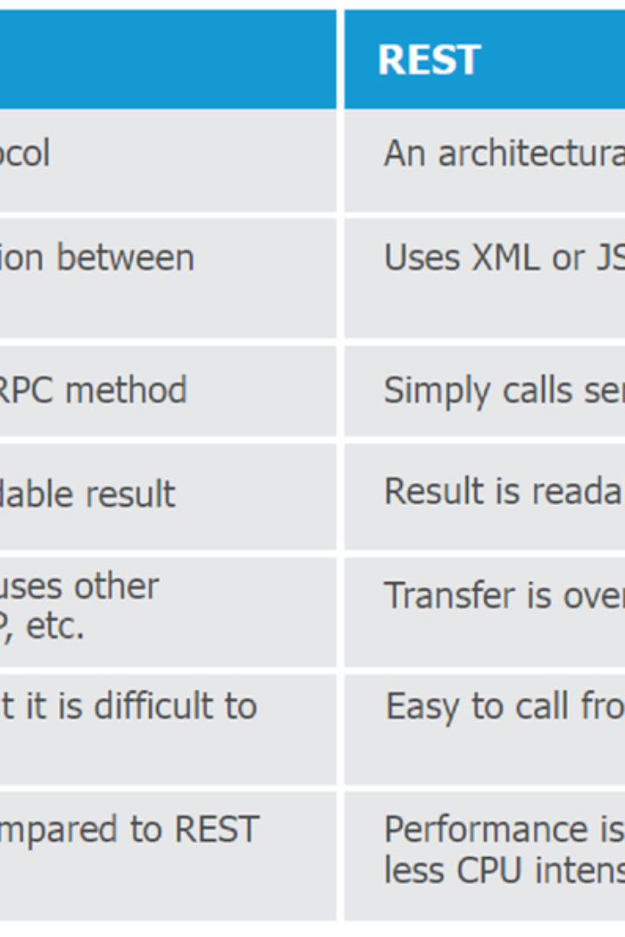


Overview of ADF Business Components
ADF Business Components is a robust framework for building Java EE based business services that interact with a database. It simplifies data access and enables the efficient writing of business logic on top of data. Development in ADF Business Components is mostly declarative through metadata, providing a clear separation of data views from business logic and validation. It implements best practices and design patterns for Java EE applications.
by Vinod Gummadi

Slide 2
Entity Objects
Represent Tables
Behaviors and Validation
Declarative Development
Entity objects represent tables in the database and effectively map to database tables. They consist of attributes that map to columns and handle insert, update, and delete operations against the table.
Entity objects define behaviors and validation for attributes, providing a powerful mechanism for maintaining data integrity and enforcing business rules within the application.
Development and customization of entity objects are predominantly declarative through metadata, ensuring an efficient and maintainable process.

Slide 3
View Objects
Query Representation
Data Filtering
Declarative Control
View objects represent queries against data. They can be based on single or multiple-entity objects, offering extensive flexibility in retrieving and presenting data.
View objects define specific sets of data through filtering, joining, and more, ensuring that the data retrieved aligns precisely with the application's requirements.
Declarative development is evident in the creation and management of view objects, allowing for efficient customization and maintenance.

Slide 4
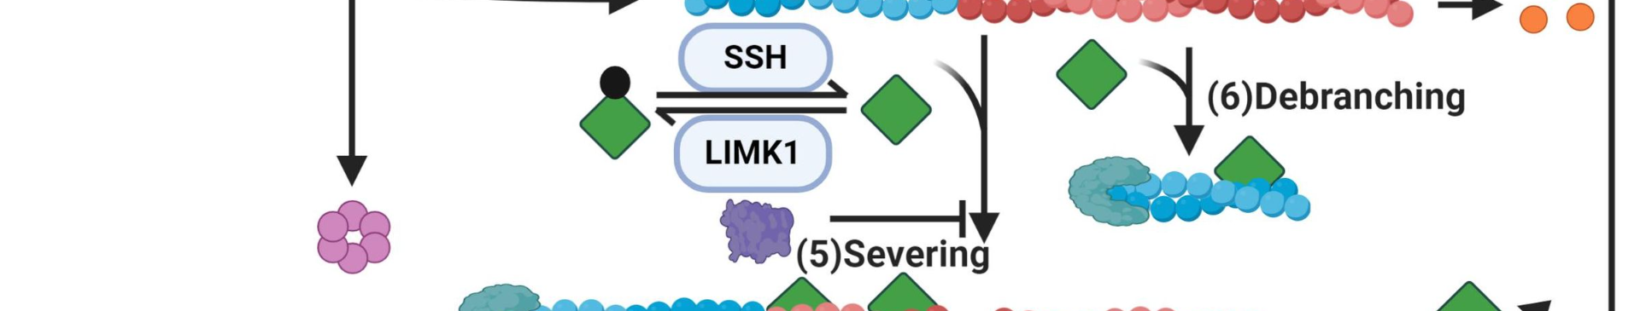
Application Model
1
Data Model Exposition
2
Component Exposure
The application model exposes the data model for developers to use, controlling database connection and transaction management for seamless integration with the UI and business logic layers.
It exposes view objects, view links, and service methods, providing a comprehensive interface for accessing and manipulating the underlying data entities.

Slide 5
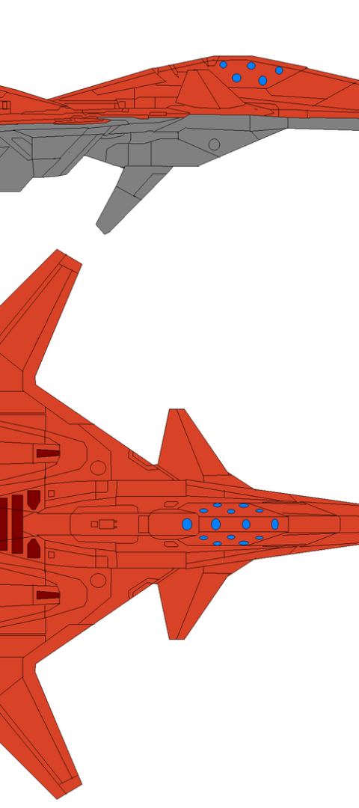

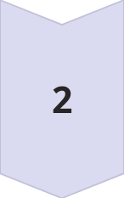
Building ADF Business Components
Create Entity and View Objects
Begin by mapping to database tables and creating read-only view objects directly from tables.
Develop Application Model
Create an application model to expose the components effectively, ensuring seamless integration and optimal functionality.

Slide 6

Testing ADF Business Components
ADF BC Tester
Comprehensive Validation
Utilize the ADF BC Tester to interact with view objects, perform queries, CRUD operations, and validation testing, ensuring the robustness and effectiveness of the components.
Define and validate the attributes thoroughly to ensure data integrity and reliability in real-world usage scenarios.

Slide 7
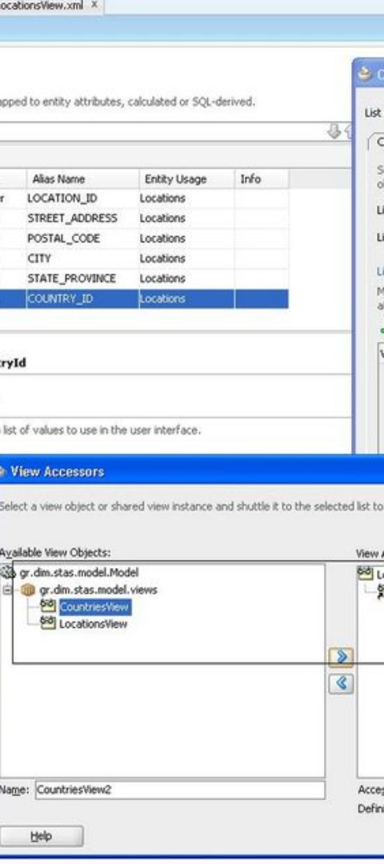
Defining Attribute Properties
1
Functionality and UI Hint Properties
2
Data Validation
Defining validation at entity and attribute level is essential, utilizing built-in validators and specifying error messages to ensure data accuracy and integrity.
It allows for the definition of functionality properties like mandatory and default value, along with specifying UI hint properties such as label, tooltip, and format mask.

Slide 8
Customizing the Data Model
1
Refining Exposed Components
Efficiently refine and customize the exposed components in the application model, ensuring optimal performance and relevance to the application's specific requirements.
2
Java Implementation Classes
Utilize Java implementation classes to override default behavior, implement complex business logic if needed, and extend functionality through hook methods.
3
Accessing the Application Model
The exposed application model can be accessed through ADF data controls for UI development, directly from Java code, and can be exposed as web services through SCA, ensuring comprehensive accessibility and integration options.

